Slide 1
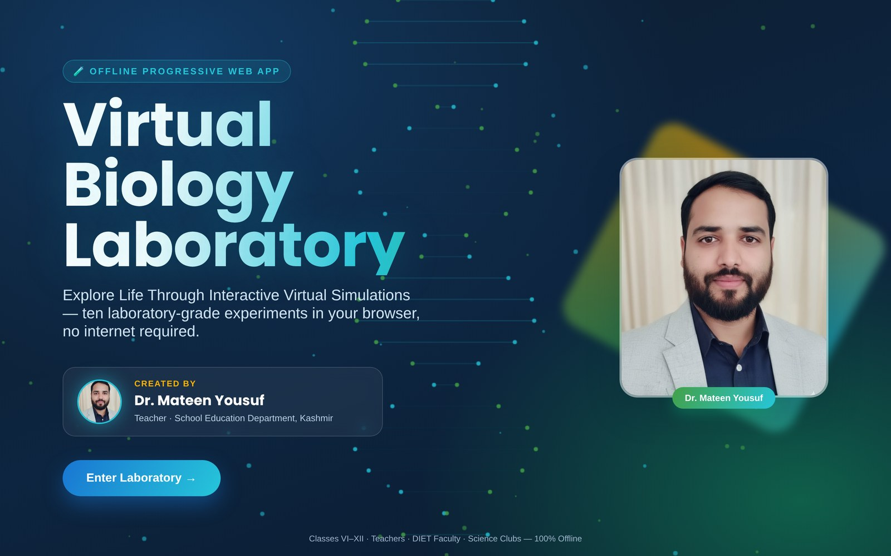
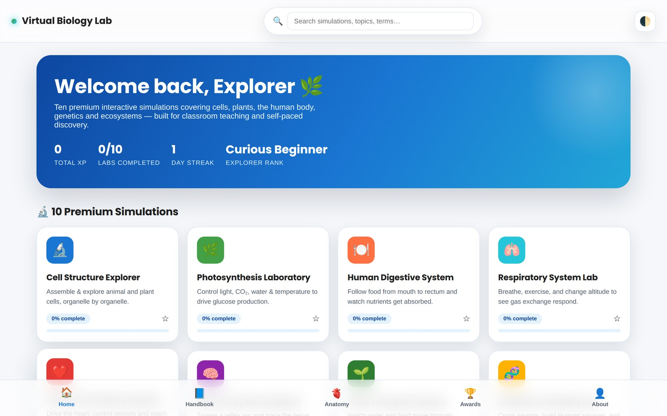

🧪 OFFLINE PROGRESSIVE WEB APP
Virtual Biology
Laboratory
Explore Life Through Interactive Virtual Simulations
PRESENTATION BY
Dr. Mateen Yousuf
Teacher · School Education Department, Kashmir
Splash Screen → Home Dashboard
Classes VI–XII · Teachers · DIET Faculty · Science Clubs · 100% Offline

Slide 2
PROJECT OVERVIEW
What Is the Virtual Biology Laboratory?
A fully offline Progressive Web App (PWA) that turns biology learning from passive memorisation into active, hands-on exploration — a complete virtual laboratory that fits in a browser tab, on any laptop, tablet, or classroom smart board, with zero internet connection required.
🔬
📴
🎮
📱
10
100%
XP +
PWA
Interactive Simulations
Works Fully Offline
Gamified Learning
Installable Anywhere
Built for Classes VI–XII, teachers, DIET faculty, B.Ed. colleges & science clubs
Recreates biological structures & processes with high scientific accuracy
Students manipulate variables, run experiments, and predict outcomes safely
Designed & developed by Dr. Mateen Yousuf, School Education Dept., Kashmir
VIRTUAL BIOLOGY LABORATORY
02

Slide 3
FEATURE HIGHLIGHTS
What Makes It a 'Premium' Virtual Lab
🧪
🎚️
📊
True Interactivity
Adjustable Variables
Live Data & Graphs
Every module is a real experiment — not a video or animation viewer.
Sliders & controls for light, temperature, exercise, genotype and more.
Real-time rate curves, population graphs and vitals as you experiment.
📝
🏆
📴
10-Question Quizzes
XP, Ranks & Badges
Installable & Offline
Every simulation ends with an adaptive mini quiz and instant feedback.
Earn XP, build streaks, and unlock achievement badges as you explore.
Installs like a native app on Android/desktop; works with zero internet.
VIRTUAL BIOLOGY LABORATORY
03

Slide 4
UNDER THE HOOD
Design System & Technology
Built with vanilla HTML5, CSS3 & JavaScript (ES6+) — no frameworks, no backend, no external APIs. Every simulation, quiz and animation runs entirely client-side.
HTML5
CSS3 · Glassmorphism
Vanilla JavaScript ES6+
Service Worker (Offline)
Web App Manifest
LocalStorage Progress
COLOR PALETTE
Deep Navy
Primary Blue
Cyan
Leaf Green
Amber
100% OFFLINE-FIRST
No login. No ads. No data leaves the device.
VIRTUAL BIOLOGY LABORATORY
04

Slide 5
USER GUIDE
How to Use — Getting Started
1
Open the App
Launch index.html in any browser, or install it as an app on Android / desktop for a native, offline experience.
2
Enter the Laboratory
From the animated splash screen, tap “Enter Laboratory” to reach your personal Home Dashboard.
3
Pick a Simulation
Browse all 10 simulation cards, use Search, or continue from Bookmarks — each shows your live progress %.
4
Explore, Quiz & Earn XP
Home Dashboard — search, stats & all 10 simulation cards
Adjust variables, log observations, complete the 10-question quiz, and watch your XP, streak & rank grow.
VIRTUAL BIOLOGY LABORATORY
05

Slide 6
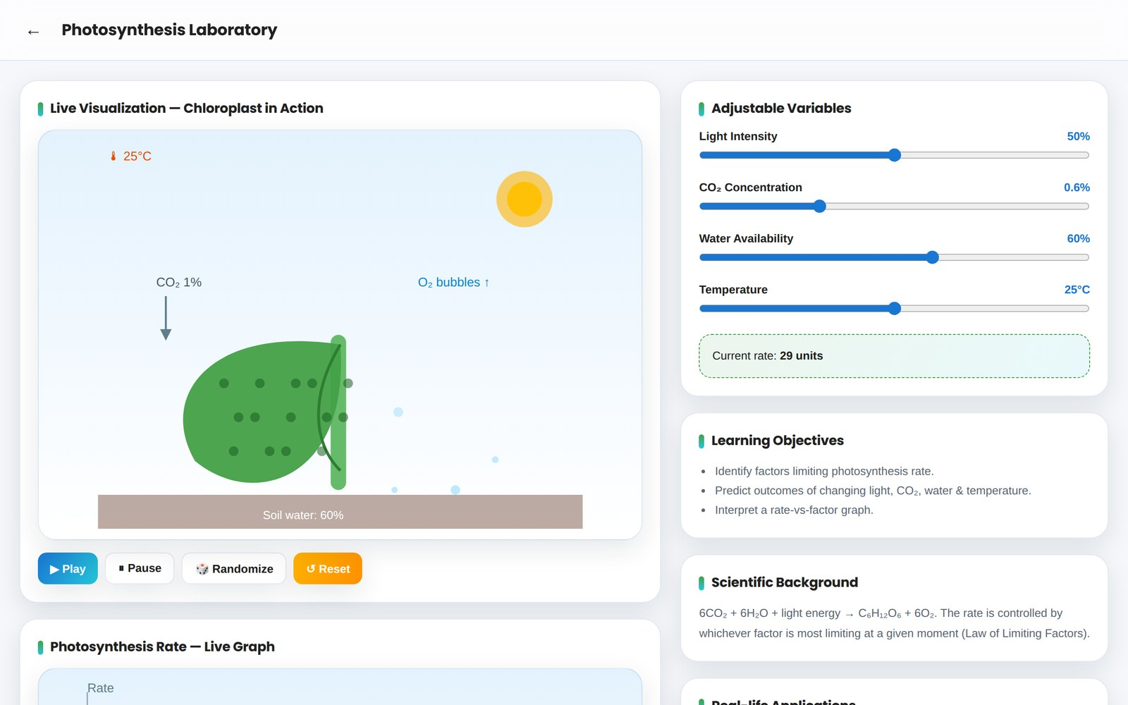
USER GUIDE
How to Use — Inside Every Simulation
Every one of the 10 labs shares the same layout, so once you learn one, you know them all.
1
Live Visualization
An animated SVG stage reacts instantly to your inputs.
3
2
Controls
Play, Pause, Reset, Step, Randomize — run the experiment your way.
1
3
Adjustable Variables
4
Sliders & dropdowns let you change the conditions being tested.
2
4
Reference Panels
Objectives, background, real-life uses, misconceptions, facts & summary.
Example: Photosynthesis Laboratory
5
Observation Log + Quiz
Record results in a live table, then take the 10-question mini quiz.
VIRTUAL BIOLOGY LABORATORY
06

Slide 7
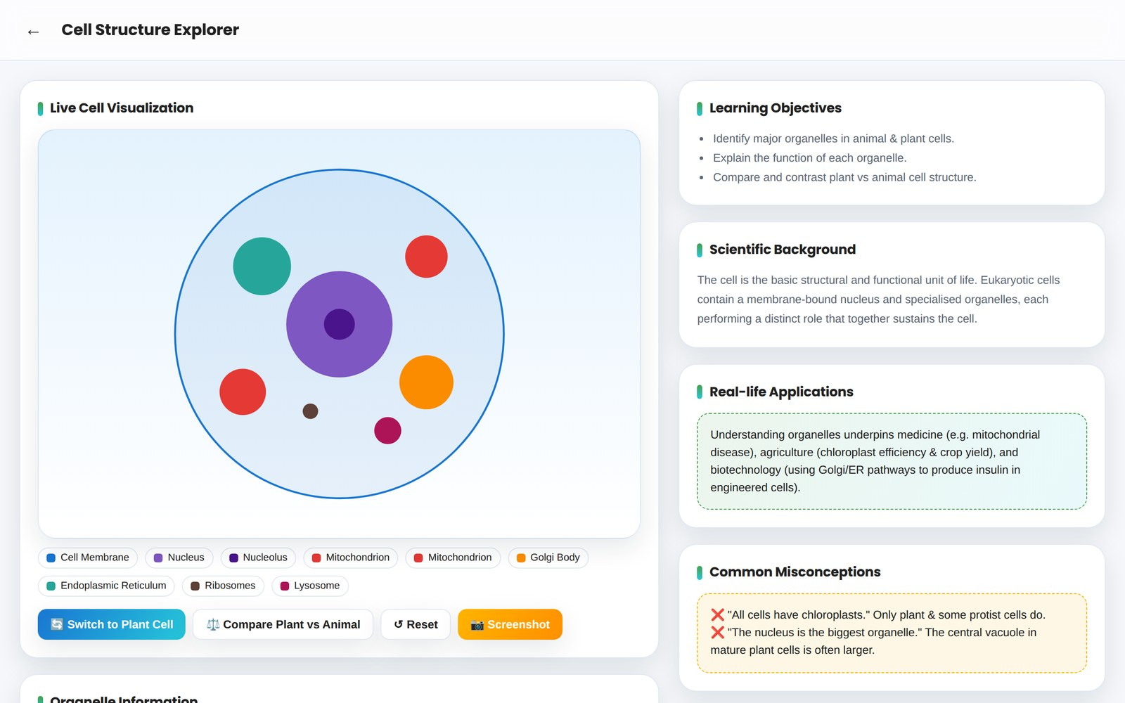
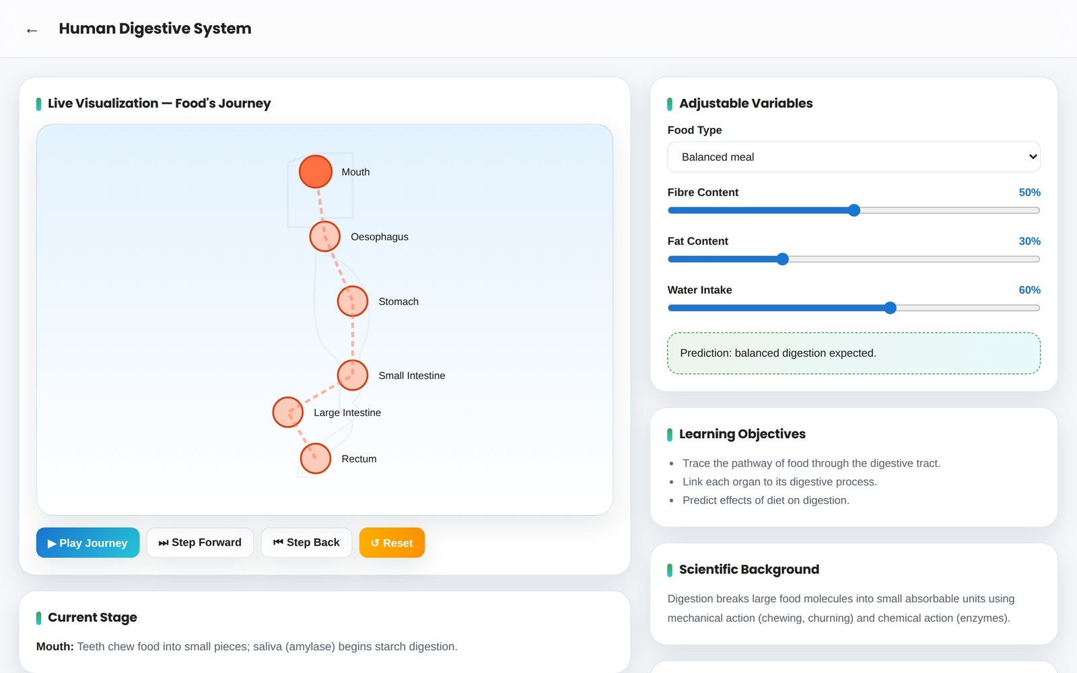
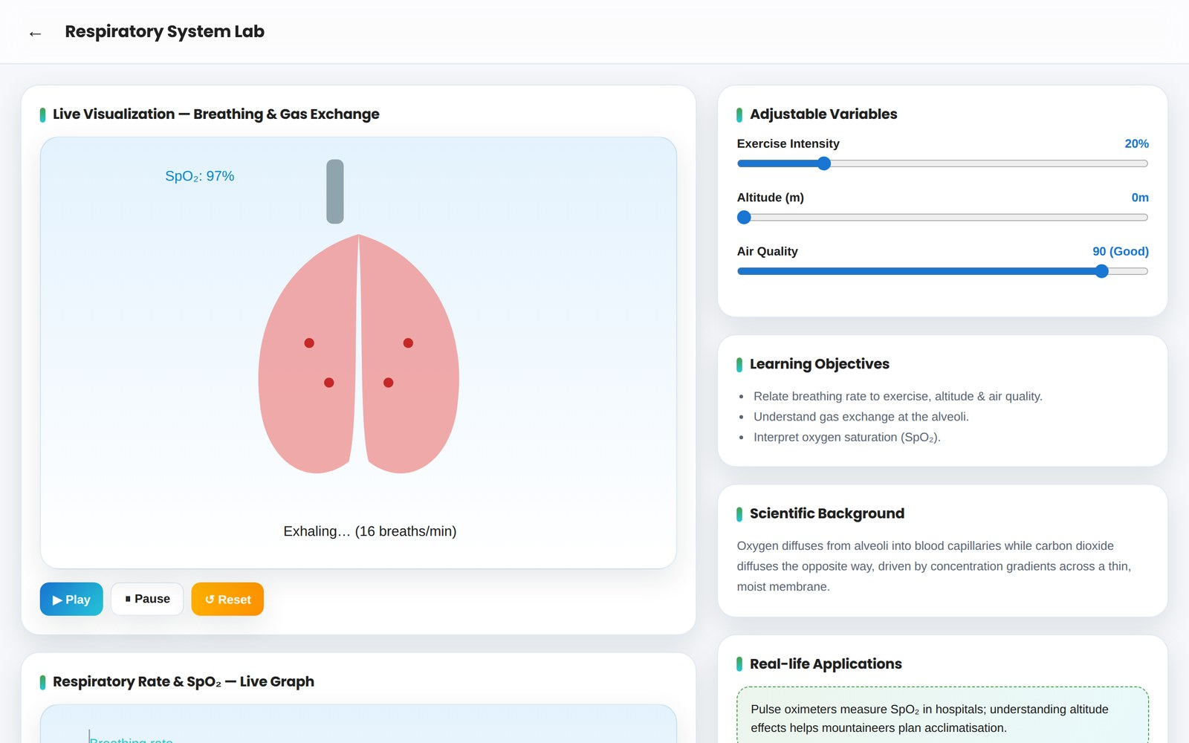
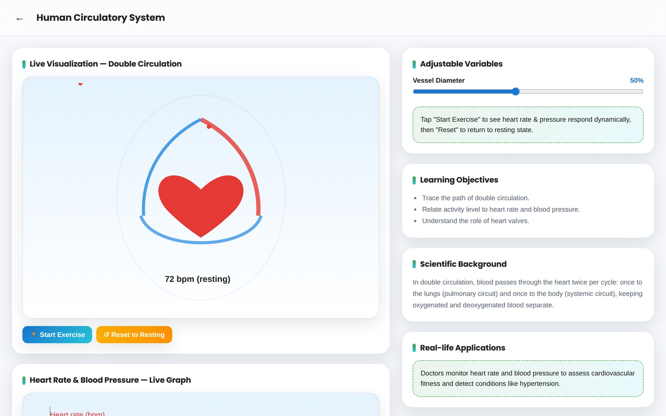
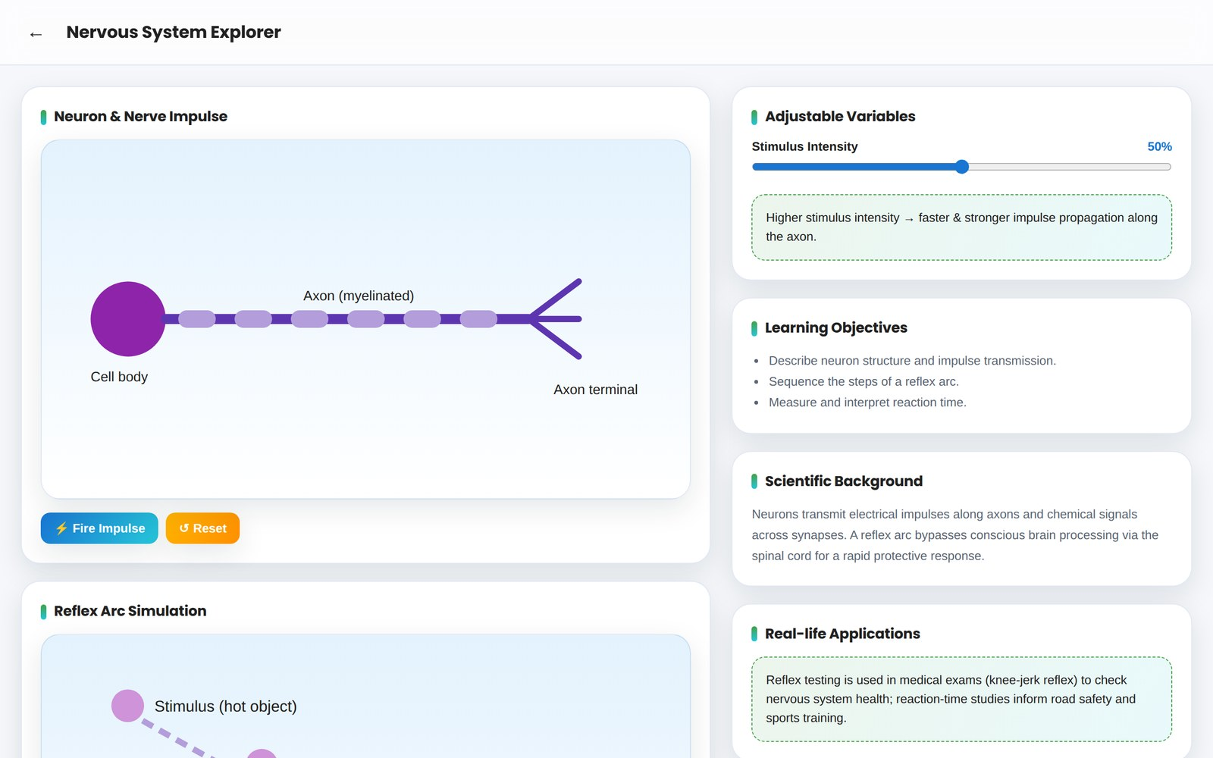
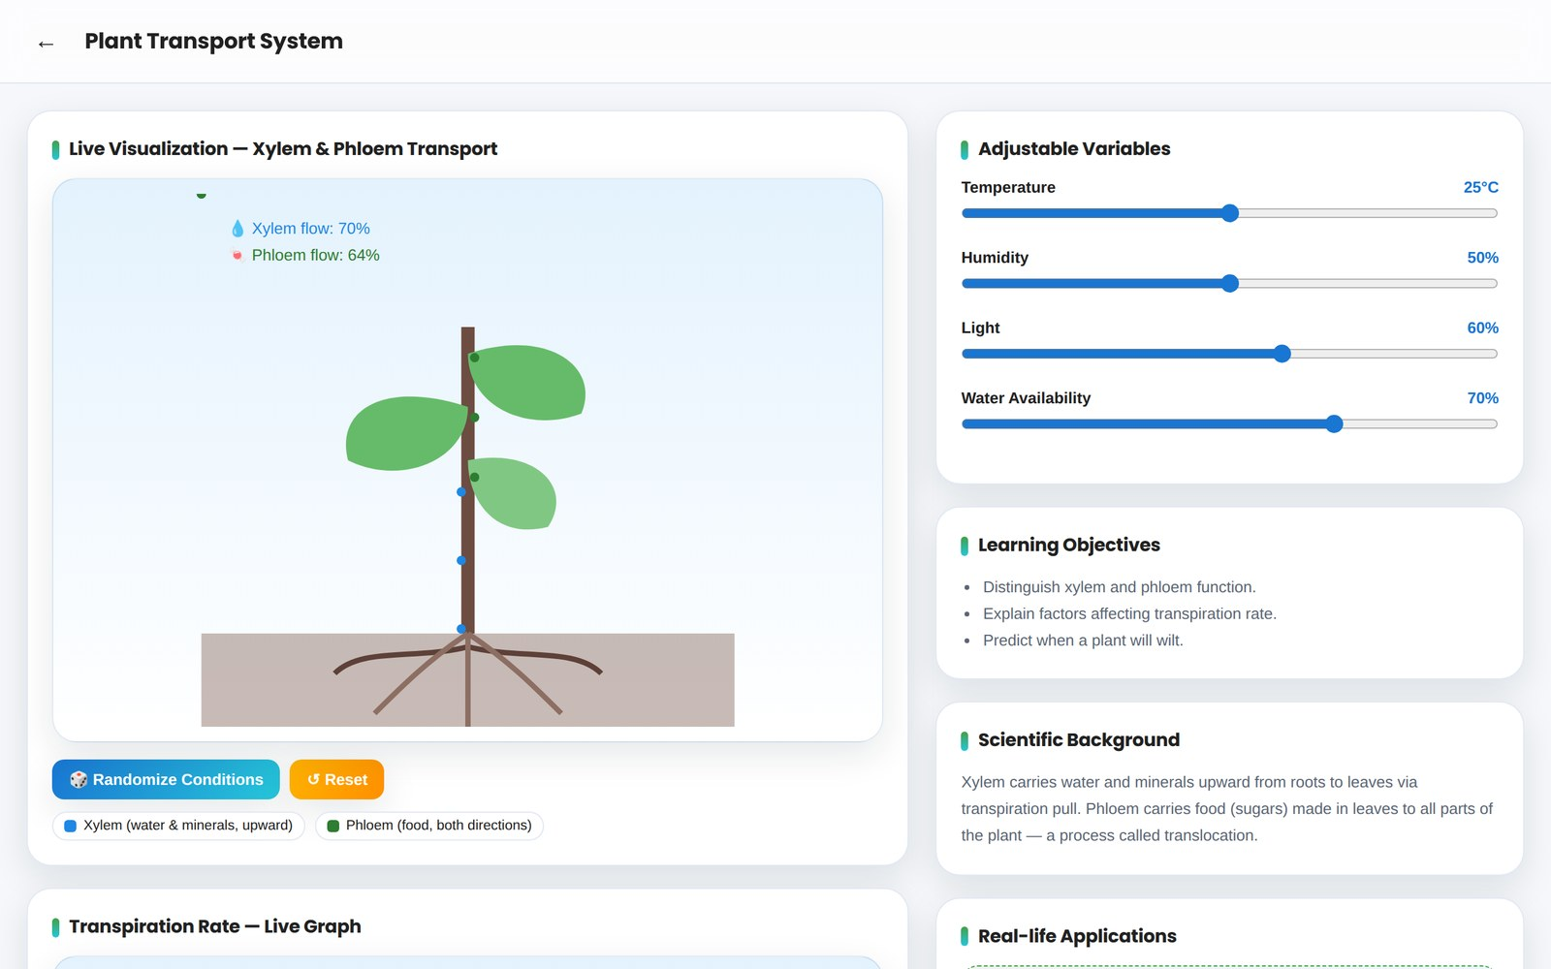
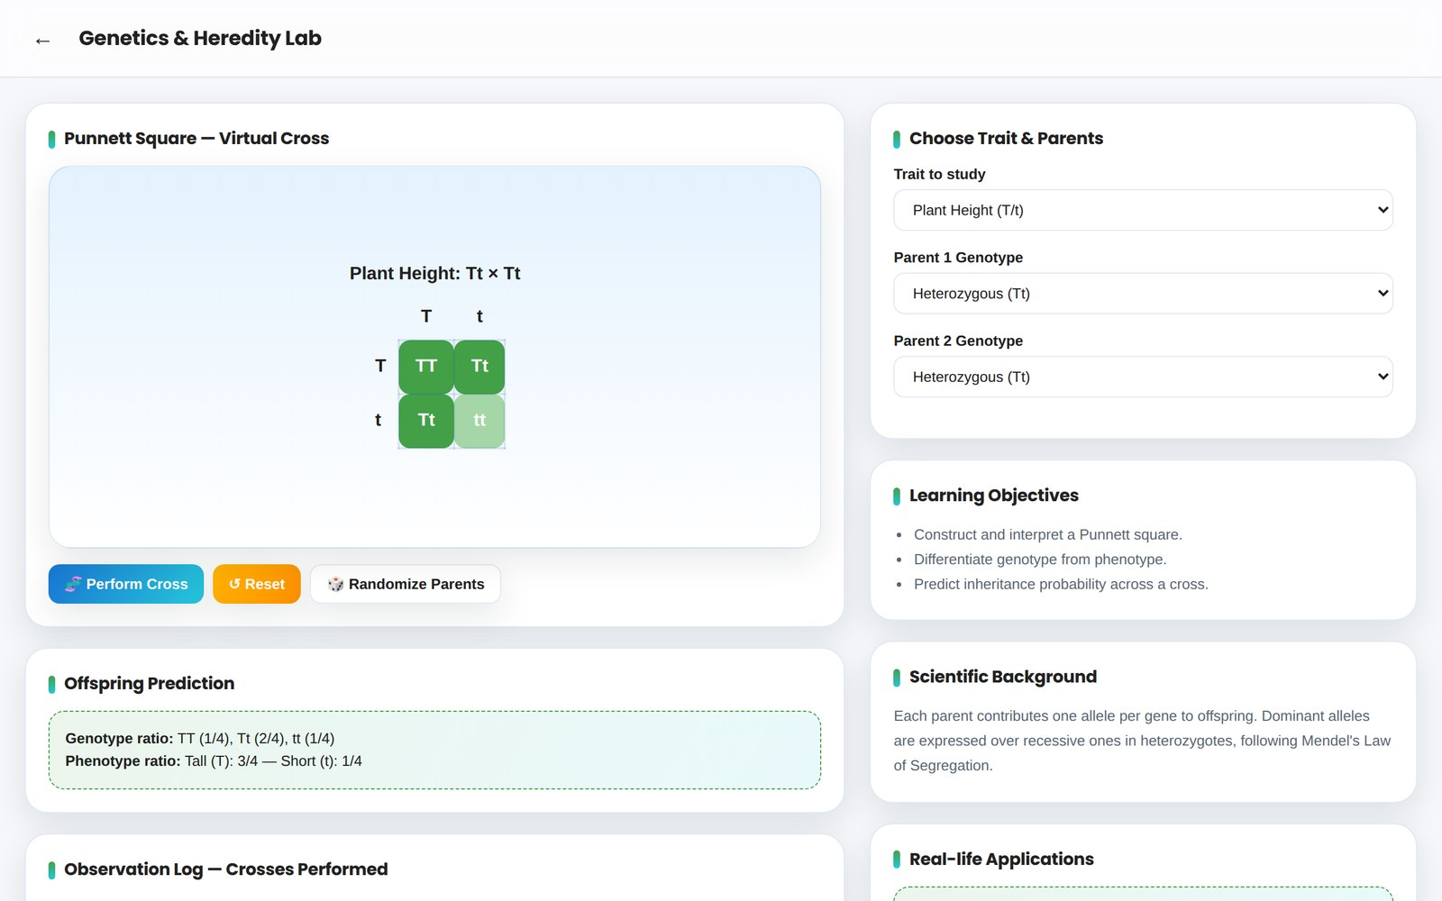
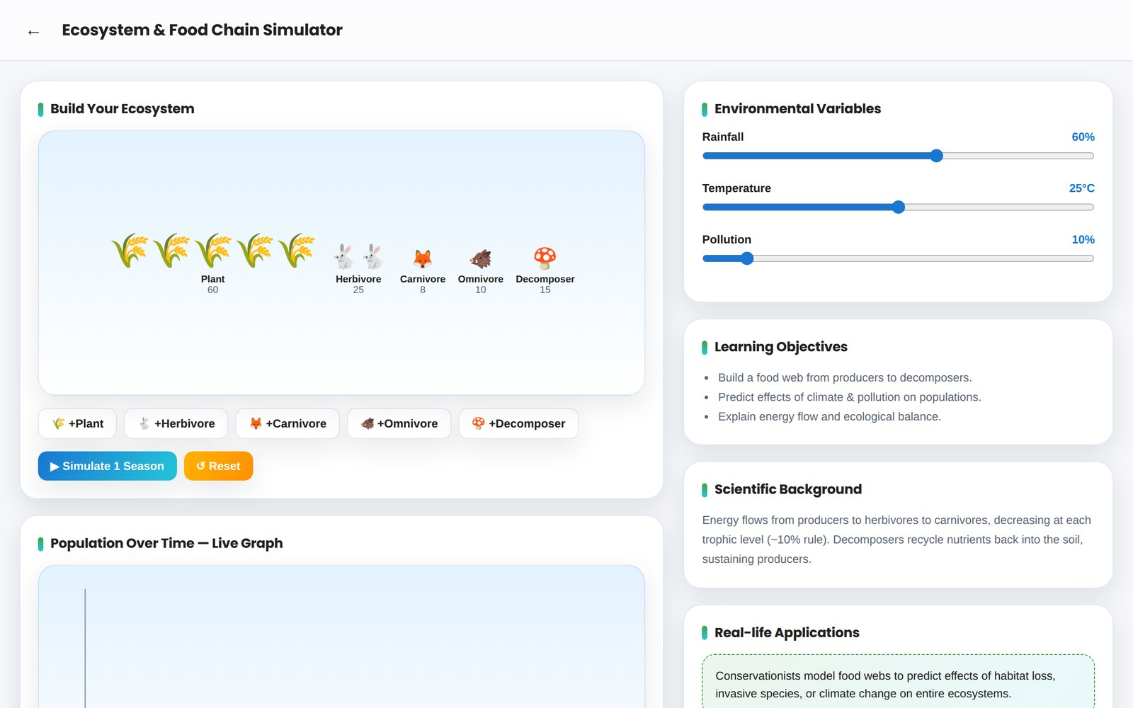
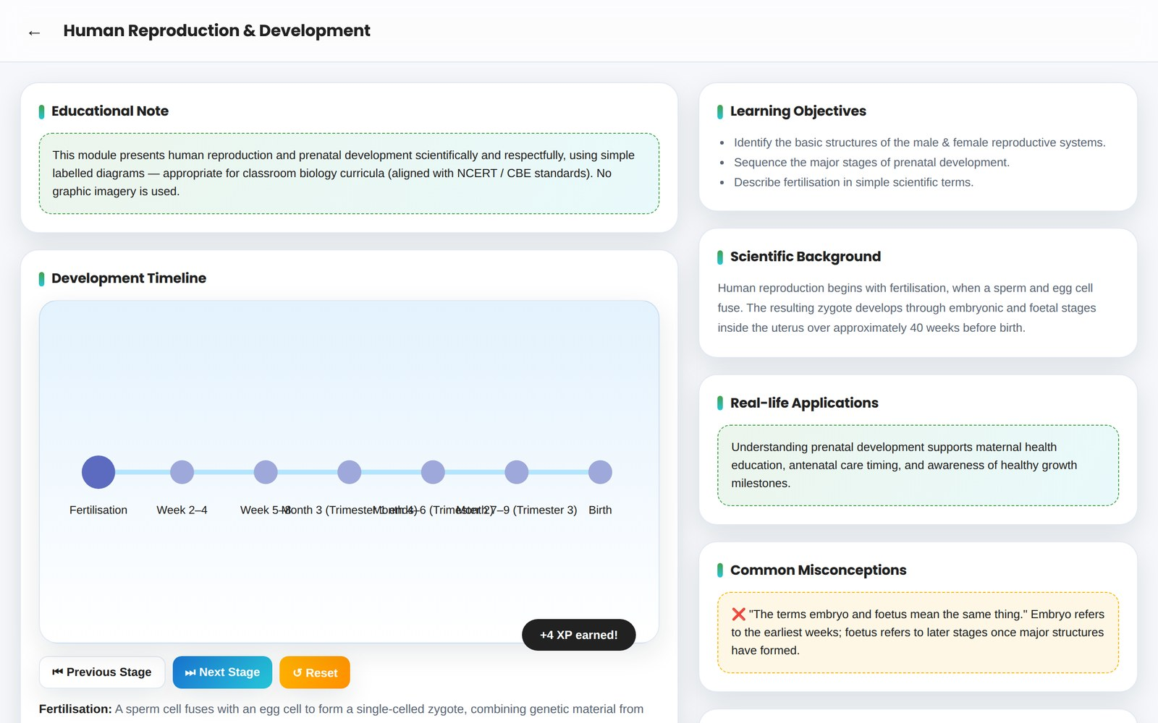
SIMULATION LIBRARY
The 10 Premium Biology Simulations
01
Cell Structure Explorer
02
Photosynthesis Laboratory
03
Human Digestive System
04
Respiratory System Lab
05
Human Circulatory System
06
Nervous System Explorer
07
Plant Transport System
08
Genetics & Heredity Lab
09
Ecosystem & Food Chain Simulator
10
Human Reproduction & Development
VIRTUAL BIOLOGY LABORATORY
07

Slide 8
01
🔬
Cell Structure Explorer
Assemble & explore animal and plant cells, organelle by organelle.
SIMULATION HIGHLIGHTS
Tap any organelle for its structure & function
Toggle between Animal Cell and Plant Cell
Side-by-side Compare mode highlights key differences
Observation log tracks every organelle explored
Simulation 01 of 10 — every module includes a live visualization, adjustable variables, observation log & 10-question quiz.
VIRTUAL BIOLOGY LABORATORY
08

Slide 9
02
🌿
Photosynthesis Laboratory
Control light, CO₂, water & temperature to drive glucose production.
SIMULATION HIGHLIGHTS
Four live-adjustable variables with instant visual feedback
Animated chloroplast with rising O₂ bubbles
Live rate-vs-time graph plots every change
Teaches the Law of Limiting Factors
Simulation 02 of 10 — every module includes a live visualization, adjustable variables, observation log & 10-question quiz.
VIRTUAL BIOLOGY LABORATORY
09

Slide 10
03
🍽️
Human Digestive System
Follow food from mouth to rectum and watch nutrients get absorbed.
SIMULATION HIGHLIGHTS
Step-by-step journey through 6 organs
Adjust food type, fibre, fat & water intake
Predicts outcomes like constipation risk
Play, Step Forward/Back controls
Simulation 03 of 10 — every module includes a live visualization, adjustable variables, observation log & 10-question quiz.
VIRTUAL BIOLOGY LABORATORY
10

Slide 11
04
🫁
Respiratory System Lab
Breathe, exercise, and change altitude to see gas exchange respond.
SIMULATION HIGHLIGHTS
Animated lungs inhale & exhale in real time
Exercise intensity, altitude & air quality sliders
Live breathing-rate & SpO₂ graph
Explains gas exchange at the alveoli
Simulation 04 of 10 — every module includes a live visualization, adjustable variables, observation log & 10-question quiz.
VIRTUAL BIOLOGY LABORATORY
11

Slide 12
05
❤️
Human Circulatory System
Drive the heart, control vessels and watch double circulation flow.
SIMULATION HIGHLIGHTS
Beating-heart animation with flowing blood particles
“Start Exercise” dynamically raises heart rate & BP
Vessel-diameter slider affects blood pressure
Live heart-rate graph over time
Simulation 05 of 10 — every module includes a live visualization, adjustable variables, observation log & 10-question quiz.
VIRTUAL BIOLOGY LABORATORY
12

Slide 13
06
🧠
Nervous System Explorer
Trigger a reflex arc and trace the nerve impulse in real time.
SIMULATION HIGHLIGHTS
Fire a nerve impulse along an animated neuron
6-step interactive reflex-arc walkthrough
Built-in reaction-time click test with results log
Adjustable stimulus intensity
Simulation 06 of 10 — every module includes a live visualization, adjustable variables, observation log & 10-question quiz.
VIRTUAL BIOLOGY LABORATORY
13

Slide 14
07
🌱
Plant Transport System
Watch water and food move through xylem & phloem under changing conditions.
SIMULATION HIGHLIGHTS
Live xylem (water) & phloem (food) flow animation
Temperature, humidity, light & water sliders
Predicts wilting when water loss exceeds uptake
Live transpiration-rate graph
Simulation 07 of 10 — every module includes a live visualization, adjustable variables, observation log & 10-question quiz.
VIRTUAL BIOLOGY LABORATORY
14

Slide 15
08
🧬
Genetics & Heredity Lab
Cross parents, build Punnett squares, and predict offspring traits.
SIMULATION HIGHLIGHTS
Real working Punnett-square generator
Choose trait (height / colour / seed) & parent genotypes
Instant genotype & phenotype ratio predictions
Cross log records every experiment performed
Simulation 08 of 10 — every module includes a live visualization, adjustable variables, observation log & 10-question quiz.
VIRTUAL BIOLOGY LABORATORY
15

Slide 16
09
🌍
Ecosystem & Food Chain Simulator
Build a food web and see how climate & pollution shift the balance.
SIMULATION HIGHLIGHTS
Add producers, herbivores, carnivores, omnivores & decomposers
Rainfall, temperature & pollution sliders
“Simulate 1 Season” evolves every population
Live multi-species population graph
Simulation 09 of 10 — every module includes a live visualization, adjustable variables, observation log & 10-question quiz.
VIRTUAL BIOLOGY LABORATORY
16

Slide 17
10
👶
Human Reproduction & Development
Explore fertilisation and the stages of foetal growth respectfully.
SIMULATION HIGHLIGHTS
Respectful, non-graphic, NCERT-aligned content
7-stage interactive prenatal development timeline
Simple labelled male & female reproductive diagrams
Age-appropriate scientific explanations throughout
Simulation 10 of 10 — every module includes a live visualization, adjustable variables, observation log & 10-question quiz.
VIRTUAL BIOLOGY LABORATORY
17

Slide 18
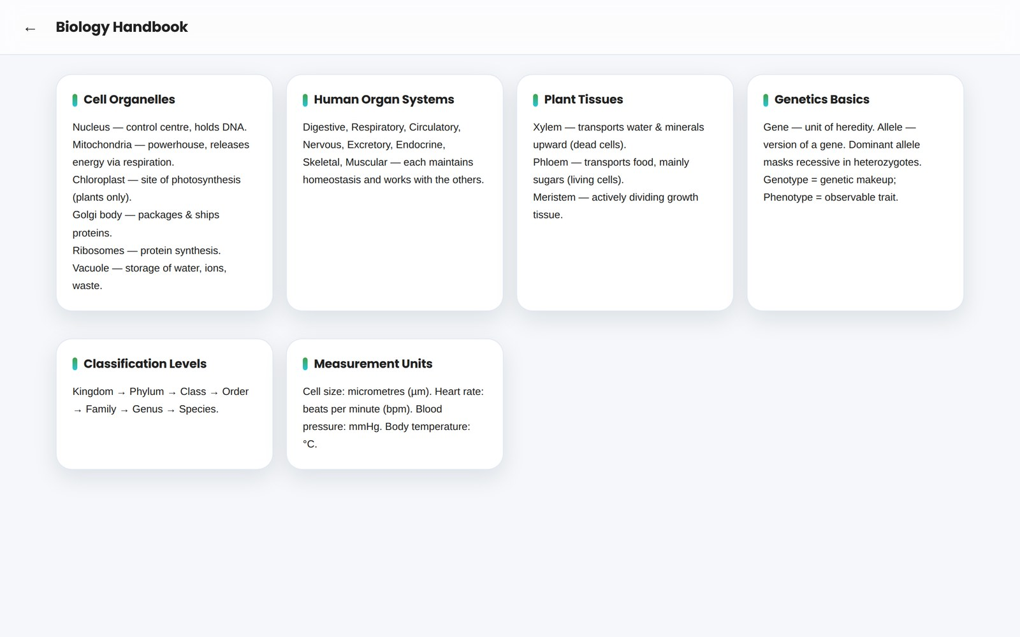
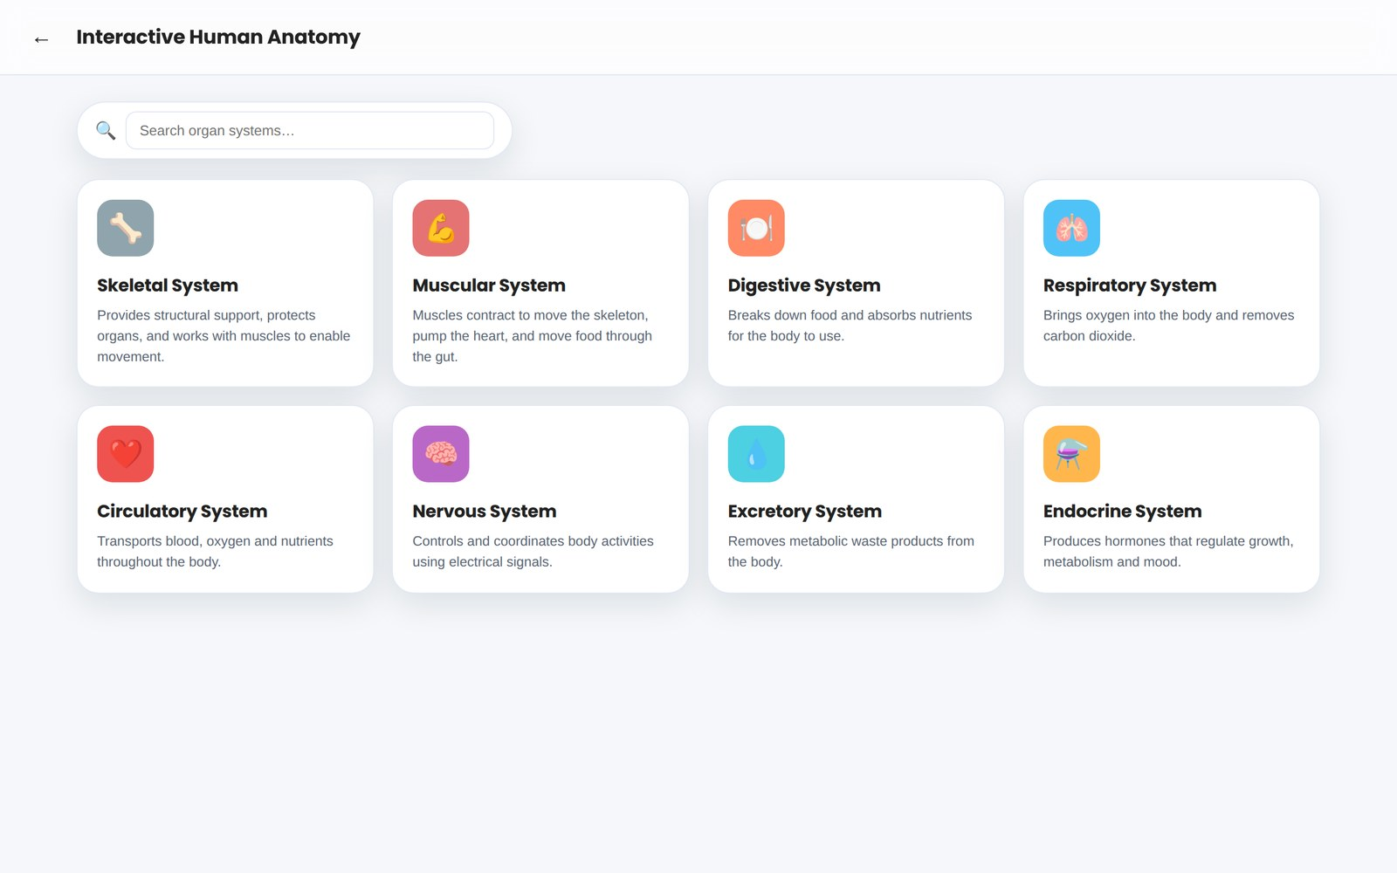
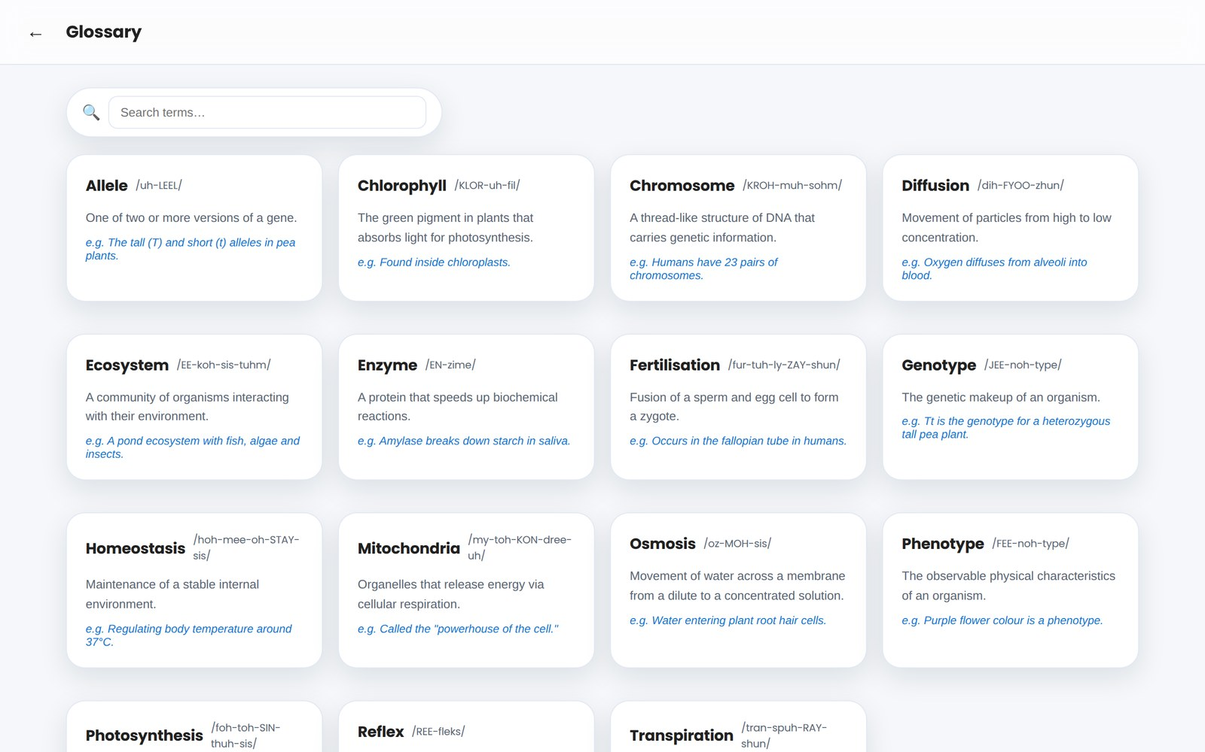
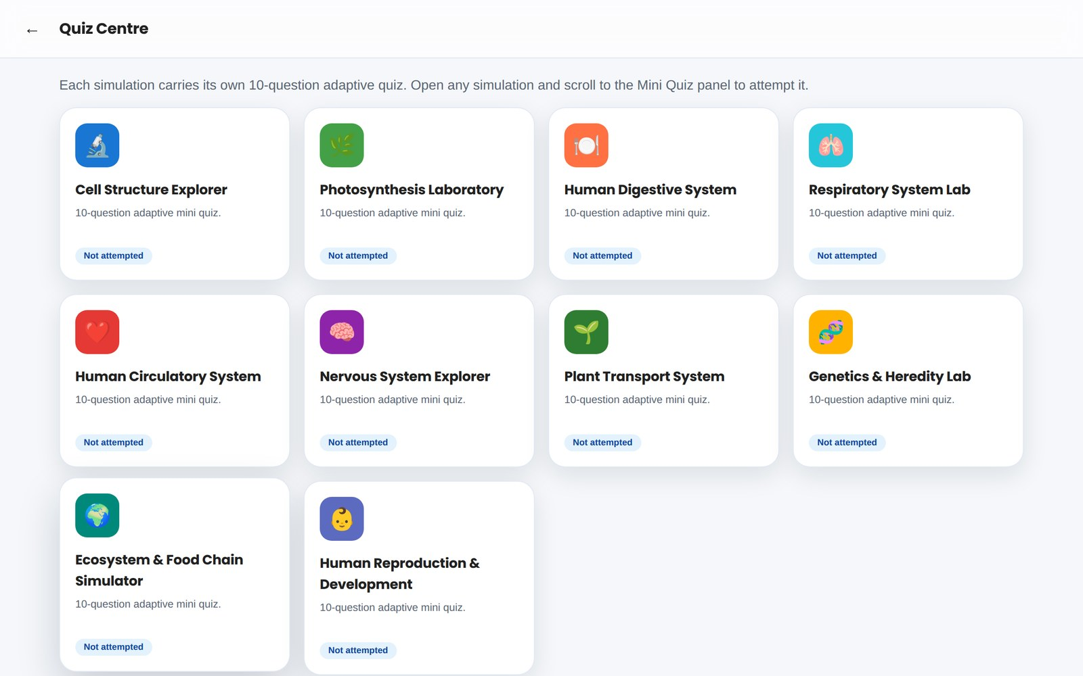
BEYOND THE SIMULATIONS
Additional Study Tools
A full learning ecosystem surrounds the 10 labs — reference material, review and self-testing, all working offline.
📘
🫀
Biology Handbook
Interactive Human Anatomy
Quick-reference notes on organelles, organ systems, plant tissues, genetics & classification.
Searchable explorer covering all 8 organ systems with organ-level detail.
🔤
📝
Illustrated Glossary
Quiz Centre
A–Z biology terms with pronunciation, definitions & real examples.
One central hub to review scores and retake any simulation's 10-question quiz.
VIRTUAL BIOLOGY LABORATORY
18

Slide 19
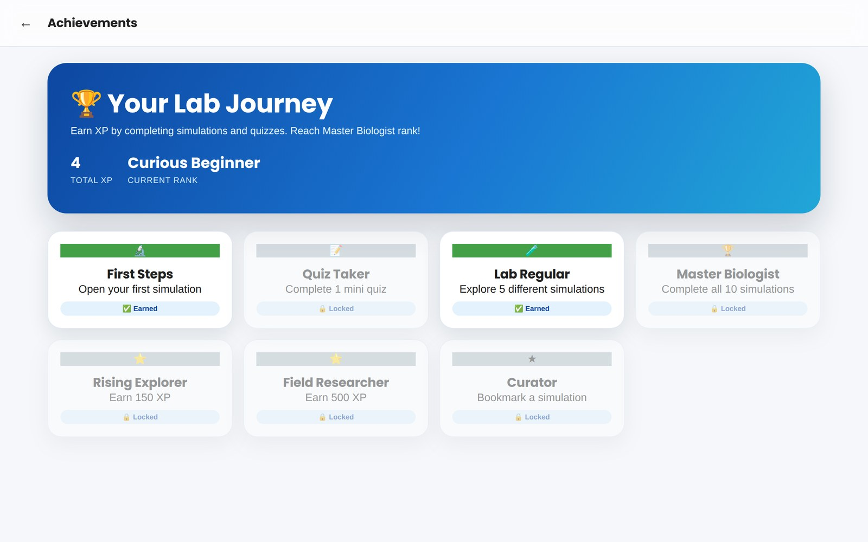
MOTIVATION & CREDITS
Gamification, Achievements & the Developer
Progress is tracked locally and celebrated — every simulation and quiz contributes to XP, streaks, ranks and unlockable badges.
1
Curious Beginner
2
Lab Explorer
3
Field Researcher
4
Master Biologist
🏆 Badges include First Steps, Quiz Taker, Lab Regular, Rising Explorer & Master Biologist.
CREATED BY
Dr. Mateen Yousuf
Teacher, School Education Department, Kashmir
NEP 2020 aligned · Competency-Based Learning
VIRTUAL BIOLOGY LABORATORY
19

Slide 20
🧬
Thank You
Virtual Biology Laboratory — Explore Life Through Interactive Virtual Simulations
Dr. Mateen Yousuf
Teacher · School Education Department, Kashmir
10 Simulations · 100% Offline PWA · Installable · NEP 2020 Aligned
20

